Slide 1

A wind tunnel for kids…
Status Update
September 8, 2011

Slide 2
Activities this week
Brought consultant on board
Jim Masters, recent PhD grad of Univ. of Tennessee Chattanooga SimCenter
AEDC Employee
Donated his 2D Fluid Dynamics Solver from PhD course work
Initiated requirements gathering
Use case driven
In terms of exhibit flow
Notes:
Two main aspects to the TunnelK exhibit - a physical tunnel and a virtual tunnel.
Consultant to assist with virtual wind tunnel..
Reason for virtual tunnel aspect is…
Our customer currently draws in younger children.
They are interested in expanding their market to high-school age youth.

Slide 3
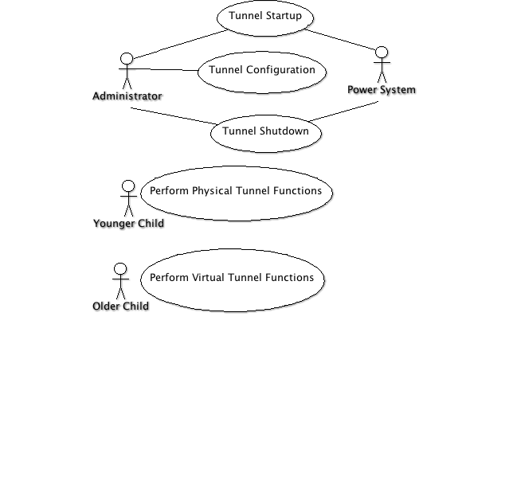
Use Case Model
Notes:
This diagram shows two main actors, tunnel admin and tunnel visitor.
Visitors are divided into younger and older, roughly equating to grade school and high school children.
Shows the power system as an actor b/c power resets are common at the Tullahoma HOSC.
Next slides go deeper into the use cases…

Slide 4
Use Case Detail - Tunnel Administrator
Use case: Tunnel Startup
Administrator powers on the system
System automatically initializes, turns on all displays, and begins waiting for user commands
Use case: Tunnel Configuration
Administrator specifies desired sensors, actuators, etc. and assigns each to an input or output channel
Administrator calibrates tunnel
Administrator tests tunnel sensors, actuators, etc.
Use case: Tunnel Shutdown
System receives shutdown command and initiates tunnel shutdown equivalent to pressing the "big red button."
Notes:
Show some detail as we think about how the tunnel will be administered.
Automatic resets based on power loss or juice box spills is a non-functional requirement that is dealt with here.

Slide 5
Use Case Detail - Tunnel Visitor
Use case: Perform Physical Tunnel Functions
User approaches tunnel
User tweaks tunnel parameters
Air speed, etc
User presses big green go button
System responds by starting up
System shows time history plots of key tunnel parameters
User presses big red stop button
System responds by shutting down the tunnel
User presses tunnel “Share” button
System sends message to social network of choice with important result characteristics
Use case: Perform Virtual Tunnel Functions
User selects a virtual model shape
User tweaks simulation parameters
User presses big green go button
System computes flow solution
System shows result of simulation
System sends message to social network of choice with important simulation results
Notes:
Use cases at this level note the two main divisions of TunnelK, a physical wind tunnel and a virtual wind tunnel.
In these use case we are starting to think in terms of exhibit flow.

Slide 6

Follow us on Twitter…
@TunnelK
Notes:
Initial social network of choice…

